Slide 1
CSS
MCNDHS
Ms. Eng

Slide 2
AIM: WHAT IS THE NTH-CHILD SELECTOR?
Do now:
Daily Grade:
On-time/attendance/not leaving the classroom: 25%
Cellphones: 25%
Notes:25%
Classwork/Homework: 25%

Slide 3
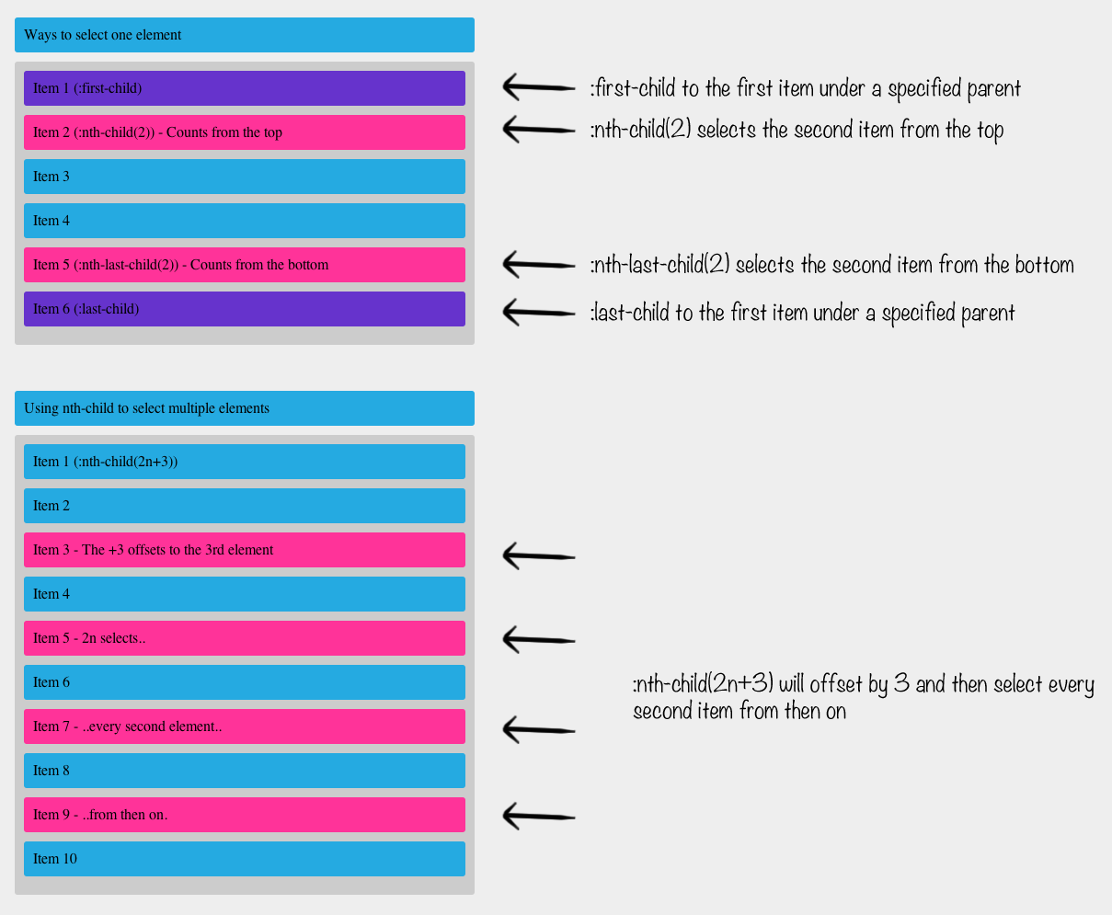
WHAT ARE WE LEARNING TODAY:

Slide 4
NTH-CHILD OPTIONS: FACTORS OF 3
element: nth-child(3n){
}
why?

Slide 5
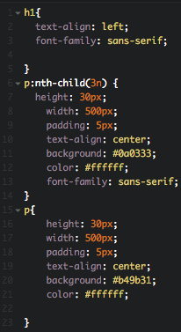
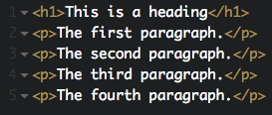
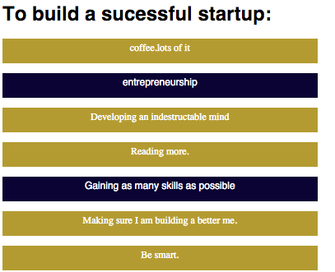
EXAMPLE:

Slide 6
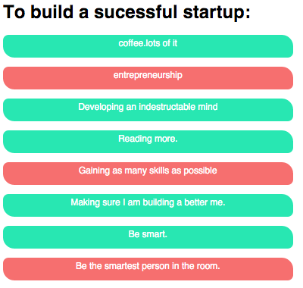
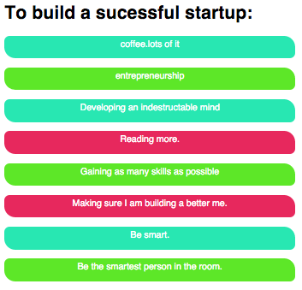
ACTIVITY
to get credit:
for extra credit:

